Slide 1

Solutions to Enhance Community-Based Census Outreach
Perla Ni,
Founder and CEO
CommunityConnect Labs

Slide 2

About Us
We help government and service providers to use mobile
messaging to connect with low-income communities
Our Partners

Slide 3
Our Technical Assistance
Last year, we built the Local Update of Census Address community canvassing tool, a sophisticated 2-way messaging software, that allowed nine municipalities across the US to add over 1.3% of their housing stock to the Census’ Master Address File.
  Worked with 40+ grassroots organizations serving hard-to-count communities, 6 California local governments
  Results evaluated by 3rd parties, governments and published in academic journals.
  What we bring: Program managers with expertise on census, engineers, relationships at the US Census Bureau

Slide 4

Canvassing
Track and Improve Canvassing Efforts in Real Time
Problem
CBOs and local governments need accurate data to coordinate canvassing efforts
Most canvassing apps are English-only, require canvassers to download apps, and are incompatible with older phones that staff and volunteers in hard-to-count communities use

Slide 5


Canvassing Optimizer
Solution
Canvassers can easily record their activities and administrators can track real-time canvassing progress
Benefits
Coordination: Provides real-time data on areas being canvassed and who is canvassing
Reporting: Provides data that can be segmented by area, nonprofit, dates, etc.
Easy to use: No need for canvassers to download an app
Accessible: Available in multiple languages for Spanish-, Vietnamese-, Chinese-speaking canvassers
Sends outcome data directly to SwORD for reporting

Slide 6
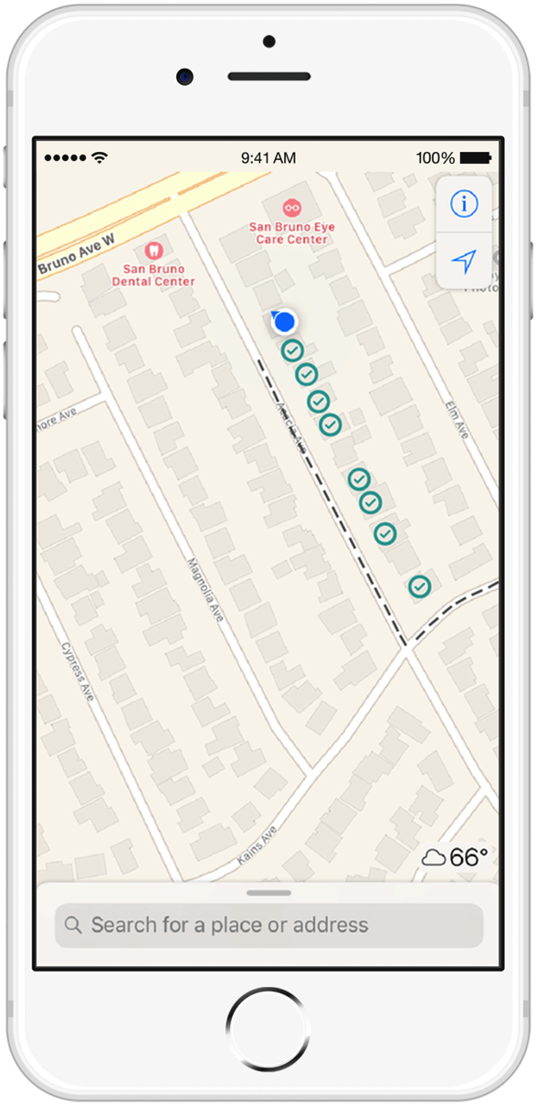
Canvassing Optimizer
How It Works
Canvassers mark households that they visited on their mobile phone.
Canvassers add info such as not home; left info; self-reported completed Census.
Data visualizations will enable administrators to see when and where doors were knocked and by which organizations and generate reports.
1
2
3

Slide 7

Re-contact & Follow-up
Automate Follow-Ups to Motivate and
Activate Hard-to-Count Individuals
Problem
Hard-to-count communities need several follow-ups, encouragement, and reminders to motivate them to participate in the census
In-person follow-ups are labor intensive
Volunteers and canvassers will be in high demand in 2020.
Follow-up content and timing needs to be aligned with the complex census timeline

Slide 8
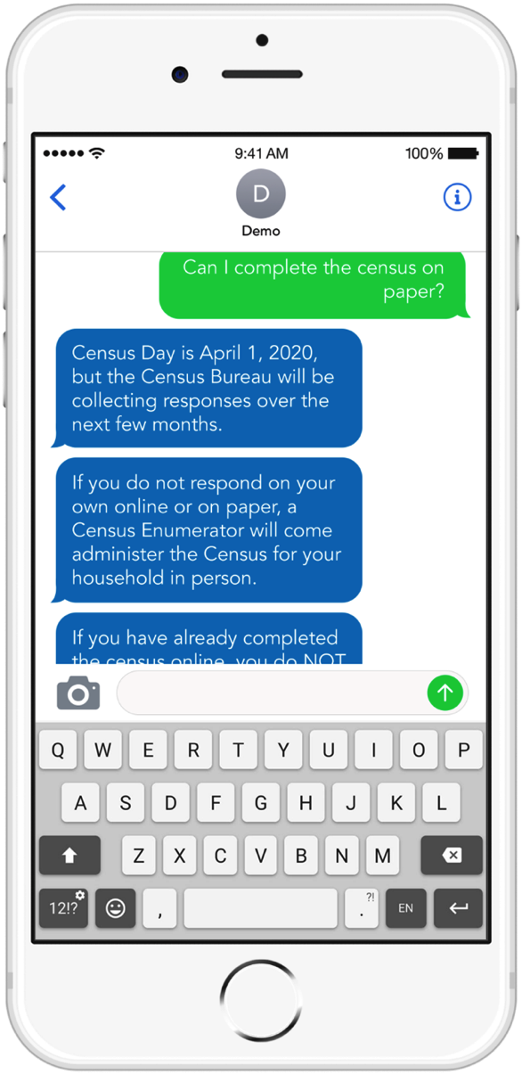
New Census Study Results:
Text Messages Are #1 Requested Follow-Up Method
Source: 2020 Census Barriers, Attitudes and Motivations Study – U.S. Census Bureau
Notes:
Our Census work:
Build technology tools with input and feedback from US Census Bureau; Census Accelerator program participant
Enabled 9 cities and counties to launch their first community based address canvassing survey
Fielded 1,000+ volunteers and government staff and over 40 CBO’s to submit 15K records of so-called “unconventional housing units”
Census Solutions Workshop partner: recent workshops in Silicon Valley, New York, King, and Salt Lake Counties

Slide 9
Community Motivator
Solution
Nonprofits can quickly and automatically follow up with contacts multiple times over the course of the census. Nonprofits can send automated, follow-up campaign with timed messages from a census content library
Benefits
Easily follow up: Launch a follow-up campaign with nudges, reminders, and help options to a list of contacts
Simplifies content creation: Nonprofits can select from library of curated, content templates in multiple languages
Reporting: Administrators can get live data such as how many people are receiving follow-up campaigns
Easily allows people to schedule in-person help or find local events for help
Sends outcome data directly to SwORD for reporting

Slide 10
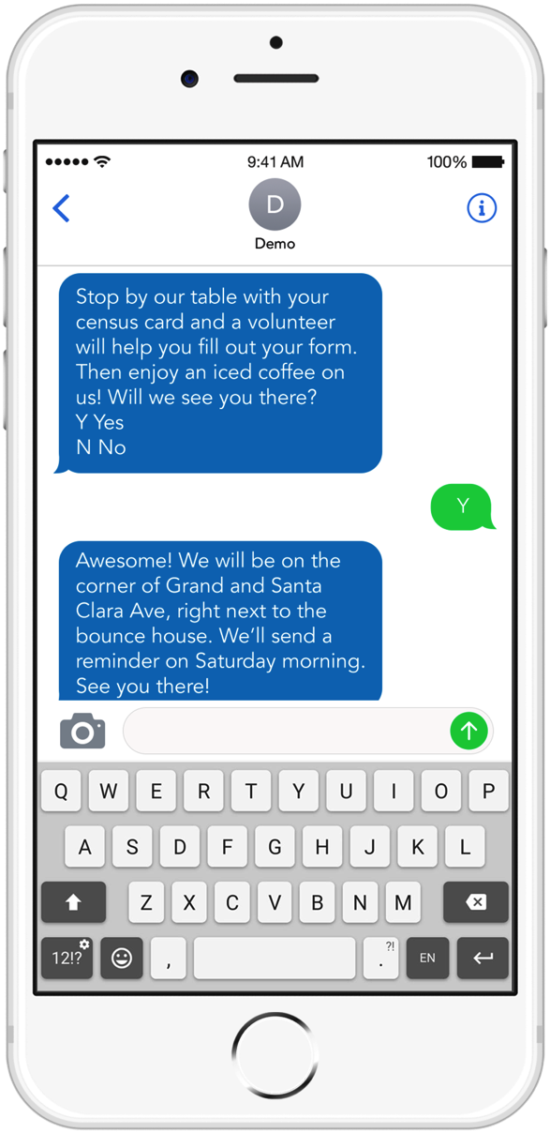
Community Motivator
How It Works
1
Upload phone number contacts or provide opt-in number at an event, meeting, etc.
Select personalization features: Content can automatically be personalized by language, location, and common communication channels (SMS, Facebook, or WhatsApp).
Select interactive features: Respondents can easily request and schedule in-person Census help.
Campaign content is synced with timeline of educational and interactive content.
2
3
4

Slide 11
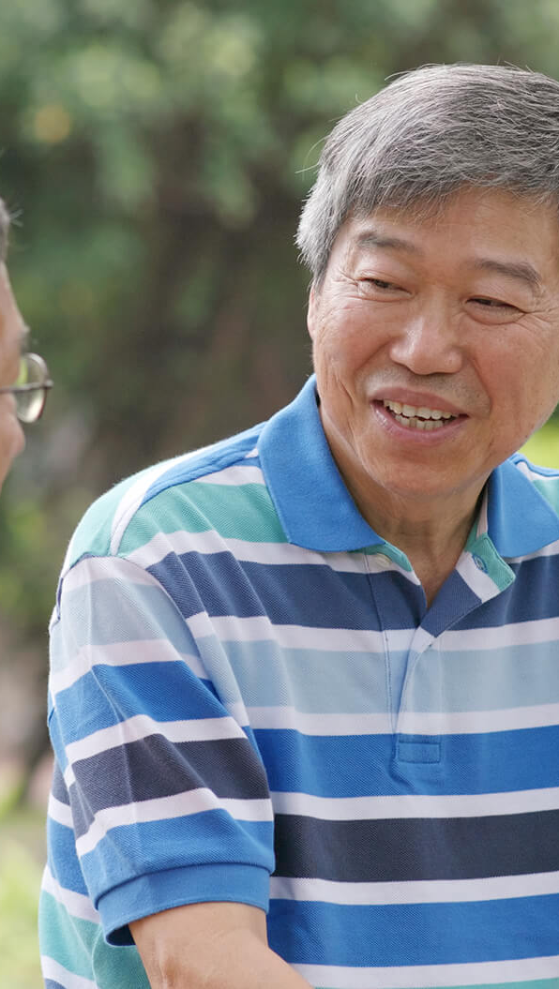
Help People With Census Questions
Provide Automated or In-Person Help
Problem
Hard-to-Count communities are likely to have questions about the Census or need help to fill it out
Hard-to-count individuals may not know where to go for in-person help to fill out their Census
People may have sensitive questions about the census and hesitate to call the Census Bureau for help
Staffing burden for cities, counties, and nonprofits to answer questions
Staff may not have sufficient census knowledge to answer questions

Slide 12
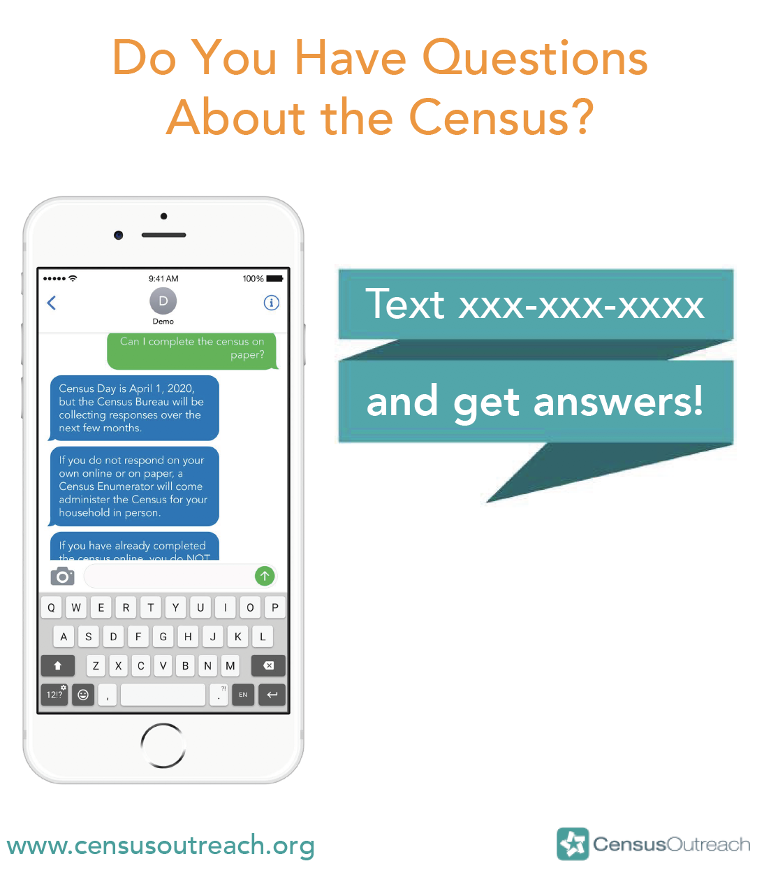
Example Outreach Flyer

Slide 13
Help Desk
Solution
Provide a resource that can help find the nearest in-person assistance center, or can provide automated answers quickly and confidentially
Benefits
Automated Help:
Removes staffing burden on city, county, or nonprofits
Available 24/7
Accessible in multiple languages
Reporting: Administrators can get live data, such as what questions people have asked
Find In-Person Assistance Center:
Get links to map and directions to locations closest to your ZIP code
Get info on hours open and languages spoken
Get reminders and other help options
Reporting: Administrators can get live data, such as how many people were referred and to which assistance centers

Slide 14
Help Desk
How It Works
1
Opt- In: Send a text to a number or mobile messaging app if you need help.
For in-person assistance, provide your ZIP code and get info on the nearest in-person assistance location with hours, languages provided, map, directions, and reminders
For automated answers, simply type your question and the chatbot will automatically answer routine questions, 24/7. Answers (when possible) will be linked to official Census FAQs and instructions.
2
3

Slide 15

How We Build This
1
Build comprehensive data set of Census questions and answers:
Crowdsource questions about the census from a large panel of 10,0000+ participants, especially hard-to-count demographics: low-income people, immigrants, minorities, parents with young children, and seniors. This phase will maximize for diversity of question topics so that our training set is comprehensive.
Match the questions to appropriate answers sourced from census experts.
Crowdsource linguistic variations of asking the same question so train our algorithm. For example, the question “How do I get a paper Census form?” could also be asked as “Can I take this on paper?”
Train AI algorithm using this training set of data
Using Google AI to train a chatbot to answer questions in 8 languages.
Maintain and refresh the model.
Beta launch with 500+ beta users
Monitoring & evaluation. Make refinements and adjustments as necessary
2
3

Slide 16


Thank You
Learn More About Census Tools and Technical Assistance for Your Grantees: www.censusoutreach.org
Contact Us:
perlani@communityconnectlabs.com
Follow Us
@textCCL
@communityconnectlabs

